Slide 1
Stochastic Calculus for Finance 2023/03/07
8.4.1 Analytical Characterization of the Put Price
報告人:梁嘉程

Slide 2
8.4.1 Analytical Characterization of the Put Price

Slide 3
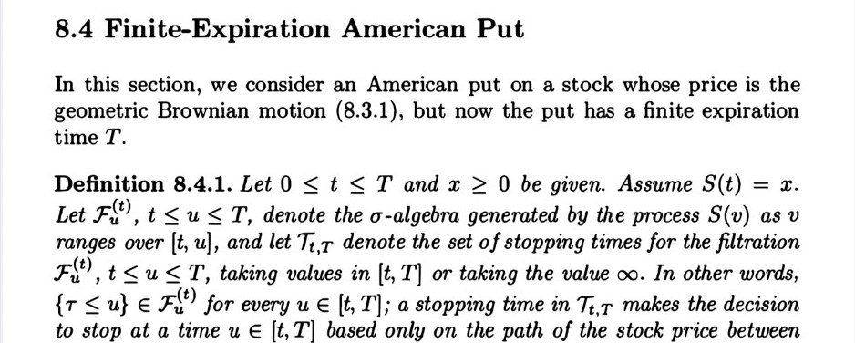
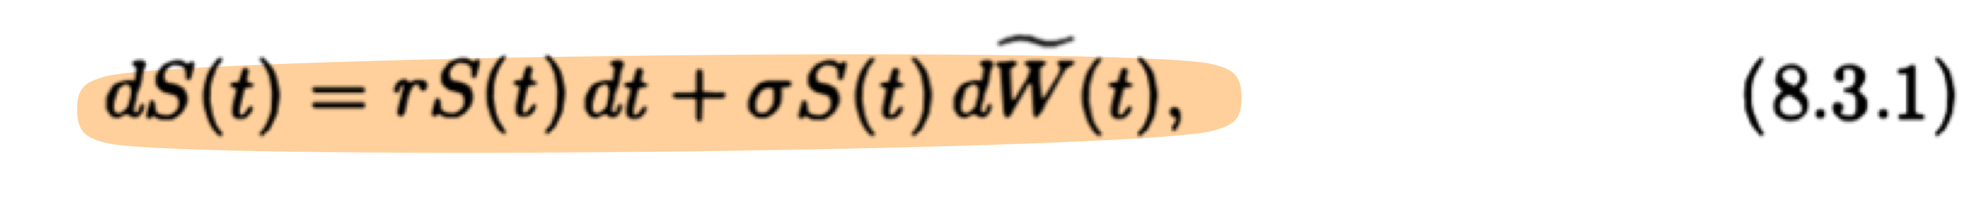
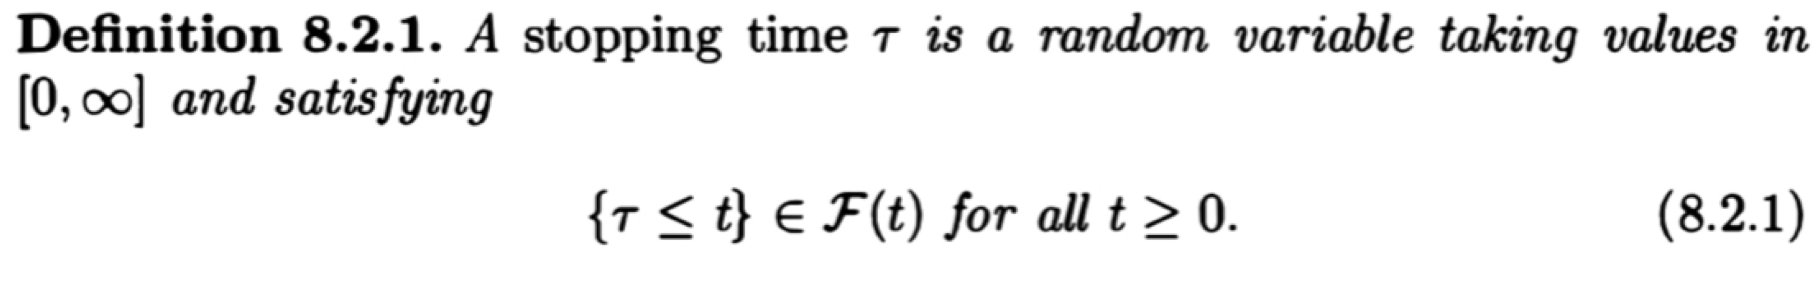
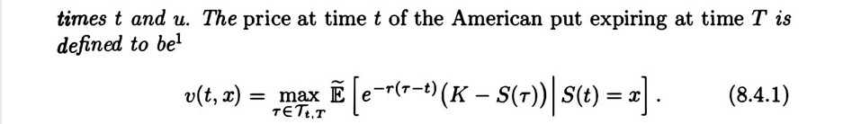

Slide 4
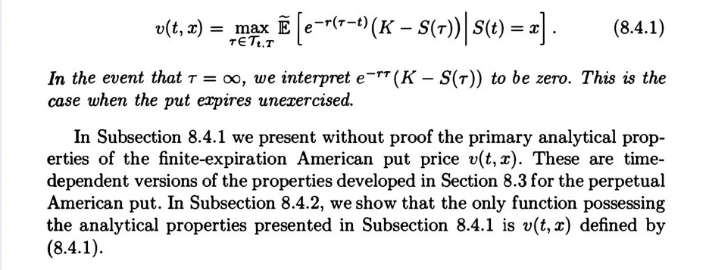

Slide 5
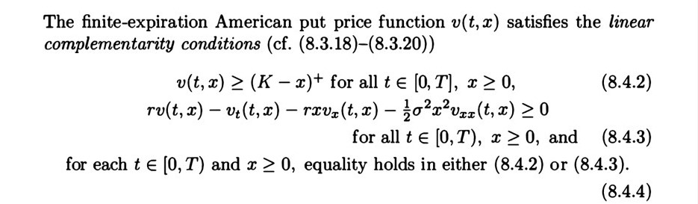
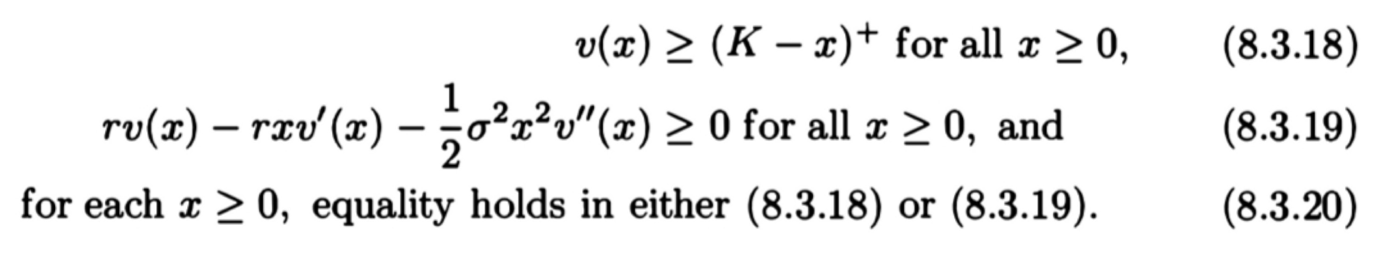
8.4.1 Analytical Characterization of the Put Price

Slide 6
Put持有人立即履約能得到(K-x)+
在t時，put價值大於實質價值(等待有時間價值)

Slide 7
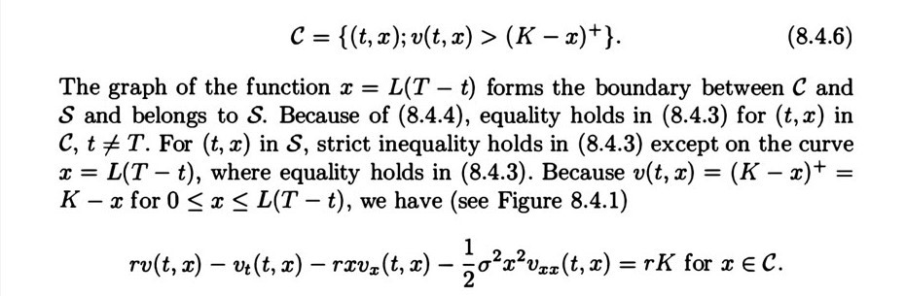
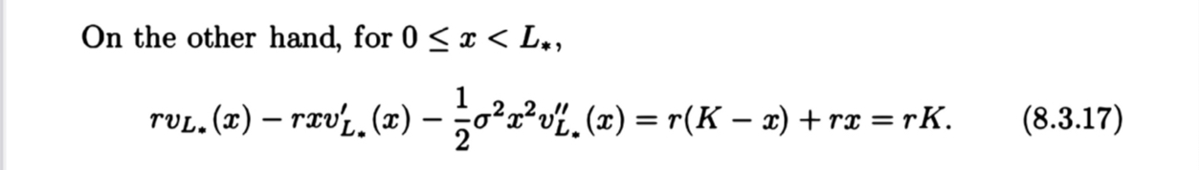
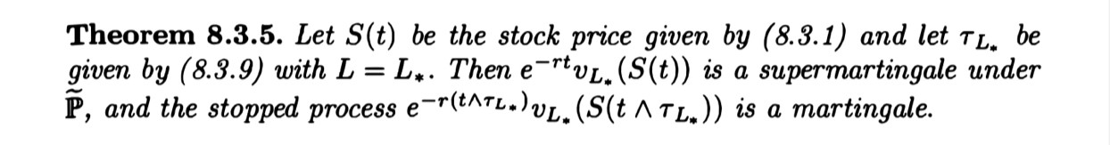
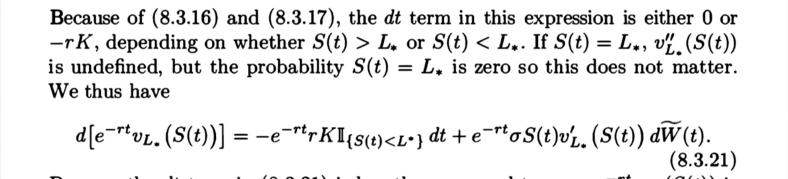
Recall:
有隨機項dt，且為負值，則爲supermartingale

Slide 8
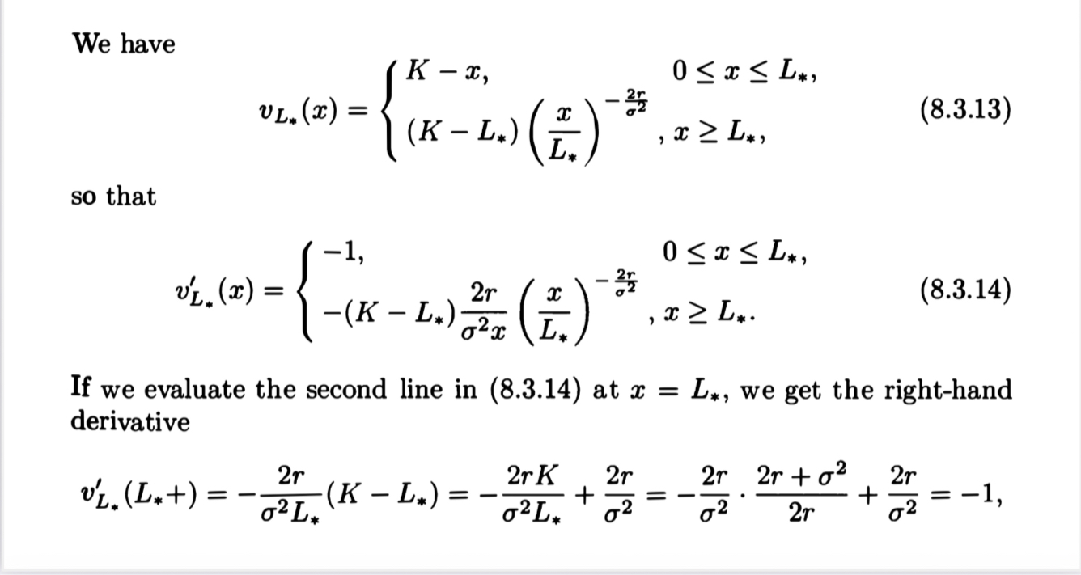
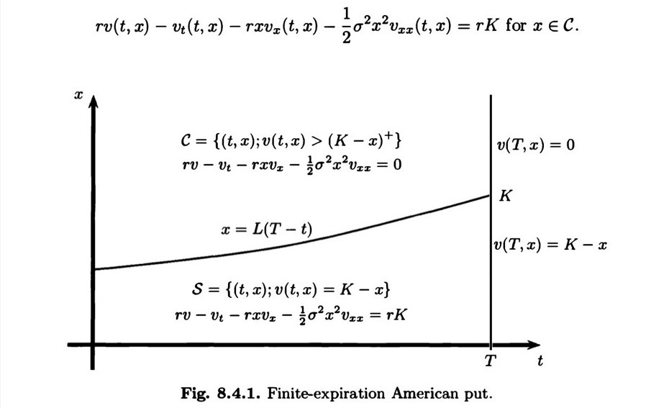
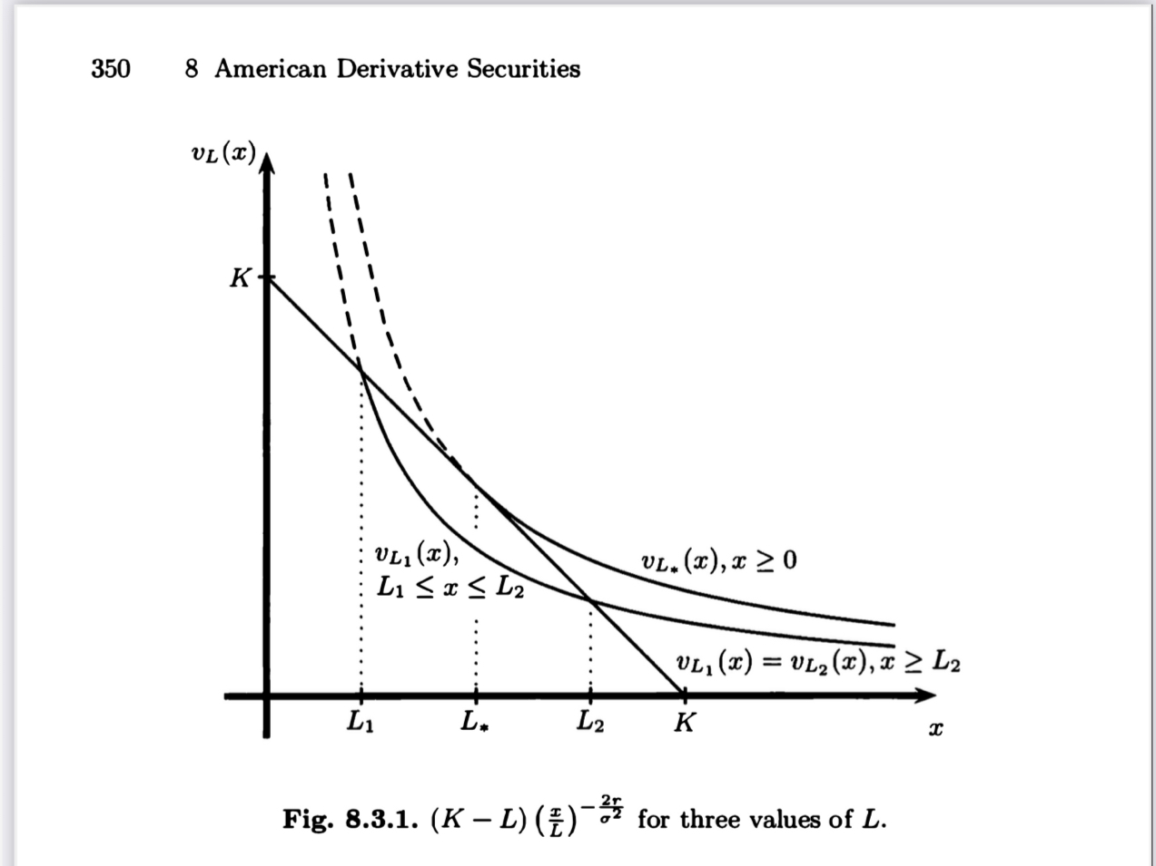
Finite-Expiration American Put無L*的解析解

Slide 9
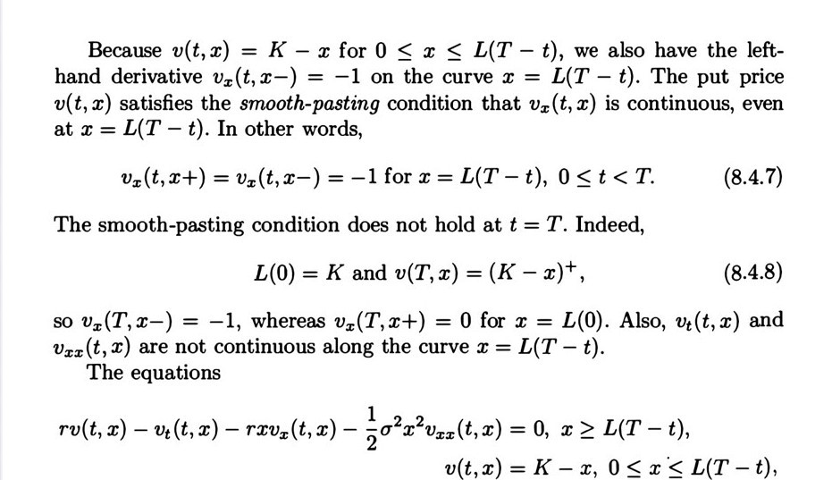
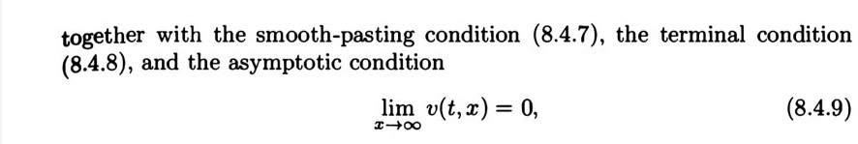
(8.4.7)應改為V(t,x+)和V(t,x-)的一階微分

